Slide 1

Chapter 6:
Building Internally Consistent Compensation Systems

Slide 2
Learning Objectives
6-1. Explain the concept of internal consistency.
6-2. Summarize the practice of job analysis.
6-3. Describe the practice of job evaluation.
6-4. Summarize various job evaluation
techniques.
6-5. Explain how internally consistent
compensation systems and competitive
strategy relate to each other.

Slide 3
Internal Consistency
LO 6-1
Compares the value of each job within the same company against the rest of the jobs found within that company
Represents job structure or hierarchy
Job descriptions are its cornerstone
Recognizes differences in job characteristics

Slide 4
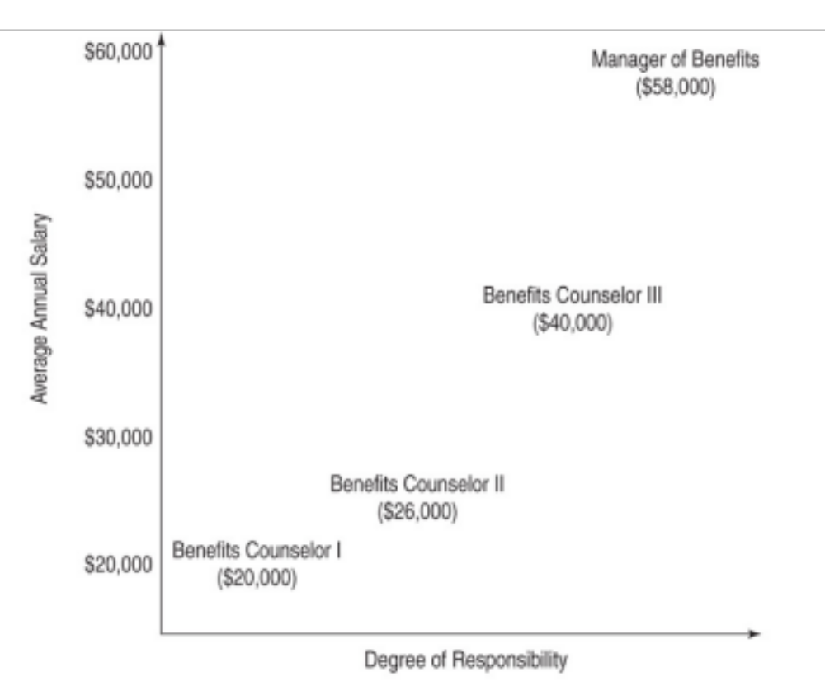
Internally Consistent Compensation Structure
LO 6-1

Slide 5
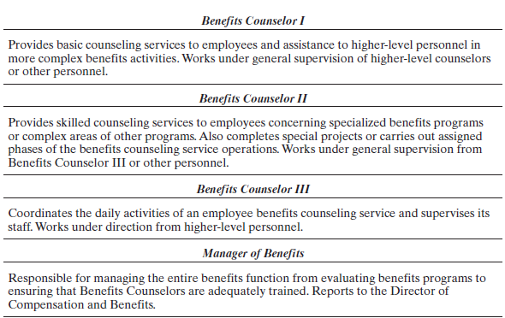
Internally Consistent Compensation Structure
LO 6-1

Slide 6
Tools for Building Job Structures
LO 6-1
Job analysis (LO 6-2)
  A descriptive procedure
  Identifies and defines job content
Job evaluation (LO 6-3)
  Reflects value judgments
  Compensation systems set pay levels

Slide 7
Job Analysis
LO 6-2
Job analyses describe:
Job content: actual activities
  Greeting clients
    Saying “Hello”
    Asking the client’s name
    Offering beverages, etc.
Worker requirements: minimum qualifications and KSAs
Working Conditions: social context or physical environment

Slide 8
Worker Requirements
LO 6-2
Knowledge, Skills, and Abilities (KSAs)
Education
Experience
Licenses
Permits
Special abilities
  Ex: HR managers must have knowledge of recruitment, selection, training, compensation and benefits, labor relations and negotiations, human resource information systems, oral/written comprehension, active listening, critical thinking.

Slide 9
Working Conditions
LO 6-2
Social context
Physical environment
  Vary along dimensions
  Based on level of noise and possible exposure to hazardous factors

Slide 10
Job Analysis Process
LO 6-2
Determine job analysis program
Select and train analysts
Direct job analyst orientation
Conduct the study
Summarize results: write job descriptions

Slide 11
Job Analysis Data Gathering Methods
LO 6-2
Questionnaires
Interviews
Observation
Participation

Slide 12
Job Analysis Units
LO 6-2
Element: the smallest step
  Ex: Connecting a flash drive into a USB port.
Task: one or more elements
  Ex: Keyboarding text into memo format.
Position: a collection of tasks
  Ex: Clerk typist.

Slide 13
Job Analysis Units (cont’d)
LO 6-2
Job: a group of positions with similar tasks
  Bob, John, and Jason are clerk typists
Job family: a group of two or more jobs with similar characteristics
  Clerical job family: file clerk, clerk typist, administrative clerk
Occupation: a group of jobs
  Office support occupation

Slide 14
Standard Occupational Classification System (SOC)
LO 6-2
SOC
  Published by the Office of Management and Budget
  Lists 23 major occupational groups

Slide 15
Sources of Data
LO 6-2
Job incumbents
Supervisors
Job analysts
Note: A review of O*Net, which falls within the scope of job analysis, follows as an appendix.

Slide 16
Reliable and Valid
Job Analysis Methods
LO 6-2
Reliable Job Analysis Method: Yields consistent results under similar conditions.
  For example, two independent analysts reach similar conclusions about the duties that constitutes a job
Valid Job Analysis Method: Accurately assesses each job’s duties or content

Slide 17
Writing Job Descriptions
LO 6-2
Should include:
Job title
Job summary
Job duties
Worker specifications

Slide 18
Worker Specifications
LO 6-2
Education
Skills
Abilities
Knowledge
Other qualifications to perform job

Slide 19
Equal Employment Opportunity Commission (EEOC)
LO 6-2
Distinguishes among the terms knowledge, skill, and ability
Skill refers to an observable competence to perform a learned psychomotor act
  Ex: Typing 50 words per minute.
Knowledge refers to a body of information applied directly to the performance of a function
      Ex: Compensation professionals should know FLSA’s overtime provisions.

Slide 20
Equal Employment Opportunity Commission (EEOC) (cont’d)
LO 6-2
  Ability refers to a present competence to perform an observable behavior or a behavior that results in an observable product
    – Ex: To mediate a dispute between labor and management successfully.

Slide 21
Legal Considerations
LO 6-2
Equal Pay Act
  Must justify pay differences
FLSA
  Determine exemption status
ADA
  Determine essential job functions

Slide 22
ADA Guidelines
Essential Job Functions
LO 6-2
Position has an essential function
Requires high skills or expertise
Decided case by case
Nonessential jobs are marginal

Slide 23
Job Evaluation
LO 6-3
Systematically recognizes differences in the relative worth among a set of jobs
Helps to establish pay differentials accordingly
Job evaluation partly reflects the values and priorities that management places on various positions
Job analysis, in contrast, is almost purely descriptive

Slide 24
Universal Compensable Factors
LO 6-3
Skill
Effort
Responsibility
Working conditions

Slide 25
Job Evaluation Process Steps
LO 6-3
Select technique
Choose committee
Train members to evaluate
Document plan
Communicate with employees
Set up appeals process

Slide 26
Two Examples of
Job Evaluation Techniques
LO 6-4
Market-based evaluation: uses market data to determine differences in job worth
Job-content evaluation: emphasizes company’s internal value system by establishing a hierarchy of internal job worth; the point method is a job-content evaluation system

Slide 27
The Point Method
LO 6-4
Most popular job-content method
Uses quantitative methodology
Evaluates jobs by comparing compensable factors

Slide 28
Point Method Steps
LO 6-4
Select benchmark jobs
Choose compensable factors
Define factor degrees
Determine weight of factors
Determine point value
Verify factor degrees and point values
Evaluate all jobs

Slide 29
Job Evaluation Qualitative Approaches
LO 6-4
Simple ranking plan
Paired comparisons
Alternation ranking
Classification plans

Slide 30
Internally Consistent Compensation Systems and Competitive Strategy
LO 6-5
Internally consistent pay systems may reduce a company’s flexibility to respond to changes in competitors’ pay practices
Narrowly defined jobs

Slide 31
Appendix (for LO 6-2)
O*NET

Slide 32
O*NET Categories
Experience requirements
Occupational requirements
Occupation specific requirements
Worker requirements
Worker characteristics
Labor market characteristics

Slide 33
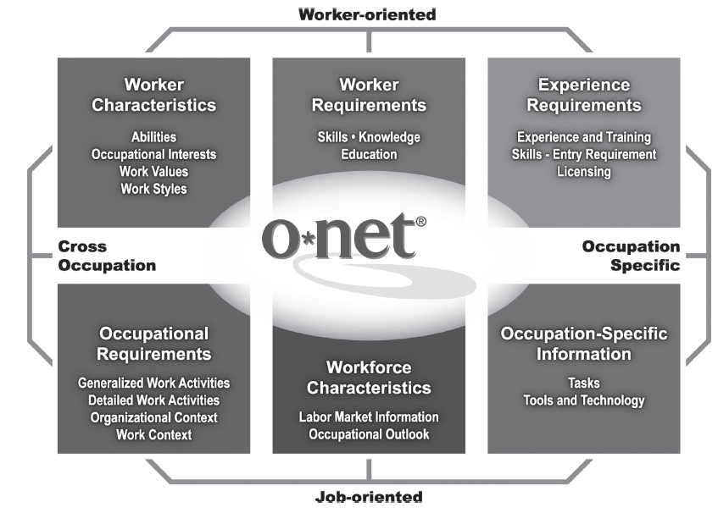
O*NET Content Model

Slide 34
Experience Requirements
Experience and training
  Related work experience
  On-site training
  On-the-job training
Licensing
  Licenses and certificates
  Formal education
Additional education and training
Organization and agency requirements
  Legal
  Employer
  Union, guild, professional association

Slide 35
Occupation Requirements
Generalized work activities
Organizational context
Work context

Slide 36
Occupation-Specific Requirements
Occupational skills
Occupational knowledge
Tasks
Duties
Machines
Tools
Equipment

Slide 37
Workforce Characteristics
Labor market information
Occupational outlook

Slide 38
Worker Requirements and Characteristics
Requirements
  Basic skills
  Cross-functional skills
  Knowledge
  Education
  Characteristics
  Abilities
  Interests
  Work styles

Slide 39
O*NET Content Model: Worker Characteristics (sample of full list)
Abilities
  Cognitive abilities
    Verbal abilities
      Oral comprehension
      Written comprehension
      Oral expression
      Written expression
    Idea generation and reasoning abilities
      Fluency of ideas
      Originality
      Problem sensitivity
    Quantitative abilities
      Mathematical reasoning
      Number facility
    Memory
      Memorization
    Perceptual abilities
      Speed of closure
      Flexibility of closure
      Perceptual speed

Slide 40
O*NET Content Model: Worker Requirements (sample of full list)
Basic skills
  Content
    Reading comprehension
    Active listening
    Writing
  Process
    Critical thinking
    Active learning
    Learning strategies
Cross-functional skills
  Social skills
    Social perceptiveness
    Coordination
    Persuasion
  Complex problem-solving skills
    Problem identification
    Information gathering
    Information organization

Slide 41
Using O*NET
HR professionals consult the O*NET user’s guide and most current O*NET database
U.S. Department of Labor Employment and Training Administration at: http://online.onetcenter.org

Slide 42

All rights reserved. No part of this publication may be reproduced, stored in a retrieval system, or transmitted, in any form or by any means, electronic, mechanical, photocopying, recording, or otherwise, without the prior written permission of the publisher. Printed in the United States of America.

